Slide 1
Boot Camp Project 2 Proposal
Ahmeda, Ziang, Molly, Dale

Slide 2

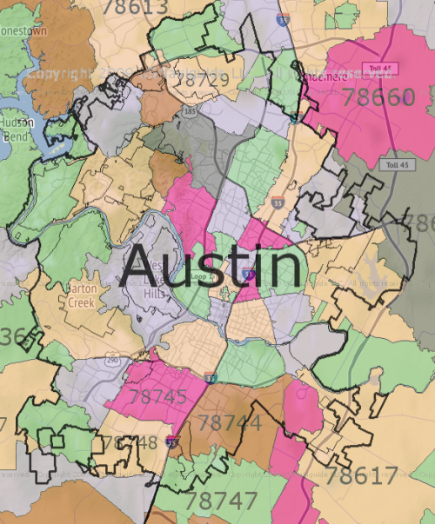

Quick Project Overview
Map of animals intake / outtake at Austin Animal Control
Overlay intake / outtake on map
Color the map by demographics (income?)
Size of marker by number of animals (or multiple circles for animal types?)
Maybe a single circle for animals, and when you click on it, it breaks out to animal types.
Scatter plot of demographics vs animal intake OR outtake (adoption).
This would allow a user to select between intake and outtake
Histogram of intake, outtake
X-Axis zip code
Y-Axis intake or outtake (selectable)
Color could be by zip code, income level or other demographic data we might pull in
Use APIs to collect the animal control data, which changes daily
Demographic data is probably a one-time pull, it doesn’t change fast

